Slide 1
Introduction to Data Structure & Algorithms
Lecture #
By: Abdul Aleem

Slide 2



Contents
1 Introduction
2
Motivation
3 Examples of DS
4
Classification of Data Structure
5 Data Structure operations

Slide 3
Introduction
Data Structure is a way of collecting and organising data in such a way that we can perform operations on these data in an effective way.
For example, we have data player’s name “Virat” and age 26. Here “Virat” is of String data type and 26 is of integer data type. We can organize this data as a record like Player record. Now we can collect and store player’s records in a file or database as a data structure.
In simple language, Data Structures are structures programmed to store ordered data, so that various operations can be performed on
it easily.

Slide 4
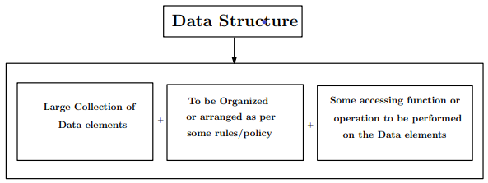
Introduction (continued)
Algorithm:- Step-by-step method or procedure to solve a problem. Program:- Implementation of algorithm in some programming language. Program is a set of instructions.
Data Structure:- Arrangement of data or Way to Organize your data.
Particular way to organize the data so that it can be used eﬀiciently

Slide 5
Motivation: Why Organization or arrangement of Data is needed
Problem Statement:- Let us consider a collection of 7 integer data elements which are given: 42,29,33,38,54,76,49
Objective:-To store the data in such a way that it can be used eﬀiciently. Just see the Procedure 1:
int p = 42; // Variable declared is of type integer
int x = 29; int y = 33; int z = 33; int n = 33; int c = 33;
int m = 33;

Slide 6
Motivation continued
Diﬀiculties in procedure 1:
Diﬀicult to keep track of or remember variable names
Searching also requires to write lot of condition to compare each variable. e.g:-Let we want to search for 76 then our condition will
be:
if(p==76) if(x==76) if(y==76)
.
.
.
When no of variable is 1000 then 1000 times we need to write the
condition.

Slide 7
Motivation continued
Procedure 2:
We arrange the data elements in a particular way.
We can see how the data element can be used eﬀiciently.
So the above arrangement takes single variable name which can store multiple value of similar type.
Search the data item 76
for i=0 to 6
{ if(N[i]==76)
}
So from the above code indicate that a lot of condition are not
required.
In Procdure 2 the structure we have used is nothing but a Data
.. .
Structure called Array.

Slide 8
Examples of DS
Example of Data Structure:
Array Linked List Stack Queue
Tree Graph

Slide 9
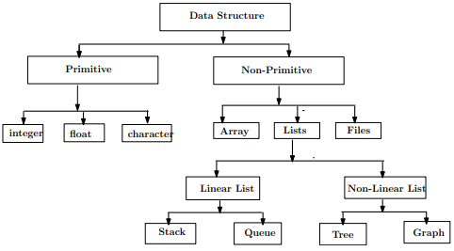
Classification of Data Structure
Data structure are normally divided into two broad categories:
Primitive Data Structure Non-primitive Data Structure
. . . . . . . . . . . . . . . .
. . . . . . . . . . . . . . . . .
. . . .

Slide 10
Classification of Data Structure
Primitive Data Structure: There are the basic structures and are directly operated by the machine. Ex-int,float,char etc.
Non-Primitive Data Structure: These data structure are derived from the primitive data structure. Ex-Array,Lists etc.

Slide 11

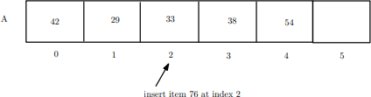
Data Structure operations
Some of the important operations on data structure are given below.
Creation:A data structure cab be created from the data elements. This operation reserves memory for data. Ex-Array
Insertion:New data items can be added to the array.

Slide 12
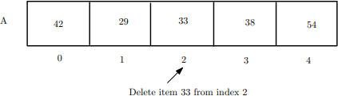

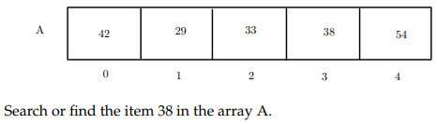
Data Structure operations continued
Deletion: Data item can be deleted from the array. Ex-Array
Traverse:Each data item in the array is visited for displaying purpose.
Searching:We can search an item from the array.
. . . . . . . . . .

Slide 13
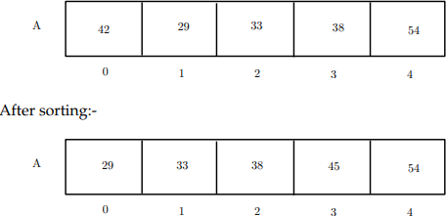
Data Structure operations continued
Sorting: Sort the element in the array in ascending or decensing order.

Slide 14
[1] Goodrich and Tamassia ‘Data Structures and Algorithms in java ’, Wiley, India.
References

